Slide 1
Arduino Session 13
SPI Protocol part 1 of 4: Arduino as SPI master (sending data to slave only)
SPI Protocol Part 2 of 4: Arduino Setting
SPI Protocol Data Transferring Buffers
SPI Protocol Part 3 of 4: Arduino as SPI master (sending/receiving to/from slave)
Hardware Interrupts

Slide 2
Sending Data to Dummy
Opening Tinkercad.com

Slide 3
SPI setting
The parameters of the communication are dependent only on the master, or need to be agreed on between devices
The most significant parameter are:
“ClockDivider” controls the speed of the SPI data bus
“SPIMode” controls the Method of data interruption
Other less significant parameters:
“OrderOfSending”
“SPIInterrupt”

Slide 4
SPI Data Transferring Buffers
Search online for how SPI works and open avrbeginners.net site

Slide 5
How to Receive Data from Dummy
Search online for how to read SPI MISO line

Slide 6
What is an Interrupt
Search online for what is an interrupt
And share with us what you find

Slide 7
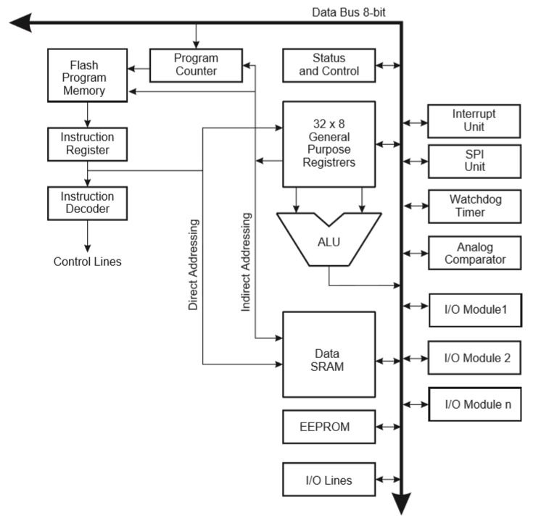
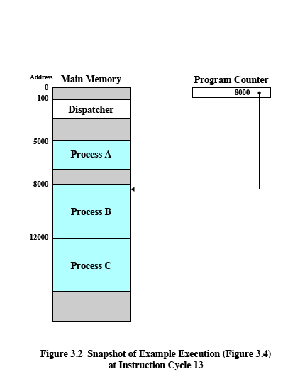
What is an Interrupt

Slide 8
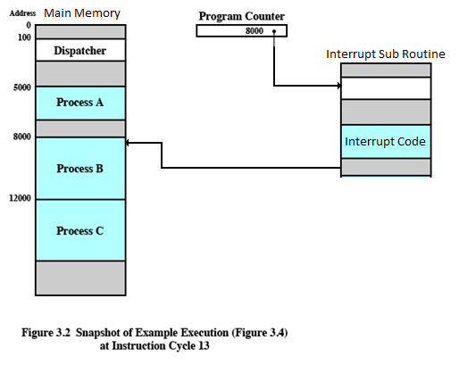
What is an Interrupt

Slide 9
How to Use Interrupt
Open a new sketch in tinkercad.com and test an interrupt code you find online

Slide 10
How to Program Dummy
Search online on how to use Arduino as a SPI slave device
Since we have a working master device, we can test writing a code for a slave device

